Slide 1
VOICING PATTERNS IN INDIAN ENGLISH*
Pratibha Bhattacharya
Department of Linguistics
University of Delhi
Delhi
* Delhi English

Slide 2
Acknowledgements
This study is part of my ongoing research work as an M.Phil student in the Department of Linguistics, Delhi University.
I owe deep gratitude to my supervisor, Dr Shobha Satyanath, Associate Professor, Delhi University, for her valuable guidance, and to the University Grants Commission, which offered me a fellowship to undertake research in this area.

Slide 3
Objective
To understand and account for the variability that exists in English(as spoken in Delhi) with reference to
1) Plural allomorphs([s],[z]and [Iz])
2) Third person singular forms and
3) Possessives.

Slide 4
Common factors among these three categories
The three categories (plurals, 3rd person singulars and possessives ) have voiced ([z],[Iz]) and voiceless ([s]) allomorphs.
These allomorphs are conditioned by the preceding phonological context.
These processes are not phonological as English shows contrast between /s/ and /z/ as in words like ‘rice’ [] and ‘rise’ [].
In English, this is a morphophonemic phenomenon, as is commonly known.

Slide 5
Plural allomorphs in English
Plurals in English have 3 allomorphs [s],[z] and [Iz] conditioned by the phonological feature of the preceding segment. For example:
Word | Transcription | Plural form | Transcription
dock |  | docks | -
dog |  | dogs | -
branch |  | branches | -
piece |  | pieces | -

Slide 6
Pedagogical rules of plural formation in English
docks [-]
  Plural → [] / C ---------------- #
  [-voice] [plural]
2) dogs [-]
Plural → [] / C ---------------- #
[+ voice] [plural]
3) branches [-]
Plural →[] / C --------------- #
[palatals] [plural]
[sibilants]

Slide 7
3rd person singulars and possessives in English
A similar phenomenon can be seen in 3rd person singulars and possessives in English
Similar rules will be applicable to these categories as well.

Slide 8
Examples of 3rd person singulars and possessives.
3rd person singulars |  | Possessives
Sentence | Transcription | Sentence | transcription
He loves flowers | - | The pub’s ambience is dull. | - 
He locks the door. | - | The pup’s nails are sharp. | - 
He caresses his dog | - | My purse’s colour is brown . | - 
He munches popcorn. | - | The bench’s colour was green. | - 

Slide 9
Additional category
Word-internal is another category taken into consideration in addition to the other three mentioned earlier.
Voicing in word-internal position in English is conditioned by the preceding and the following segment.
For example, in words like
  ‘chromosome’ []
  ‘chrysanthemum’[]
  ‘assorted’[]
  ‘absurd’[]

Slide 10
Revisiting the voicing patterns
The objective is to explore to what extent English as spoken in urban Delhi follows the same pedagogical rules with respect to plural formation, 3rd person singulars and possessives.
In other words, the objective is to find out the nature of voicing patterns in these categories.

Slide 11
Data and Methodology
Location of the study | Types of data
1.North and North-West Delhi 2. Middle-class neighbourhoods 3. Total number of speakers: 11 | Reading tasks | Spontaneous speech
 | Word lists Sentences Passage

Slide 12

Details of the data
Grammatical contexts | Number | Examples | Number of tokens generated
Word list | 468 words out of 296 were the relevant words for producing the tokens | Traps, Crabs, Bars, Figures, Mandirs, Masjids, Tantriks, Pieces, Ranges . | 3016
Sentences (comprising plurals,3rd person singulars and possessives) | 282 | a) Hurricanes kill masses and destroy property. b) He went to men’s room. c) Salman loves Katrina. | 2924
Passage (from the novel The Namesake) | 2 passages | Grandfather’s retirement Suitcases Tears | 202
Spontaneous speech |  | six [] a week | 455
 |  | hartals and bands [  ] | Total number of tokens from all the sources : 6597

Slide 13
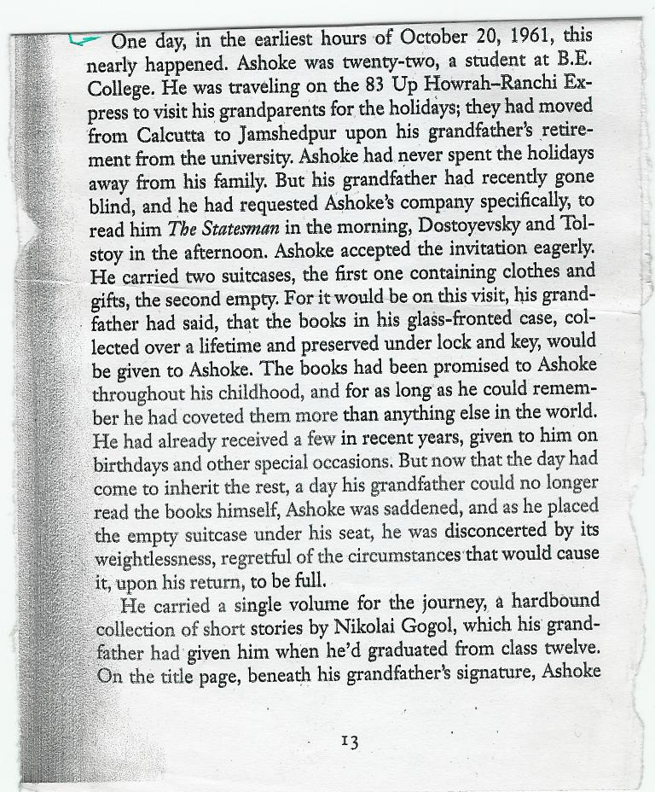
The first page of the reading passage

Slide 14
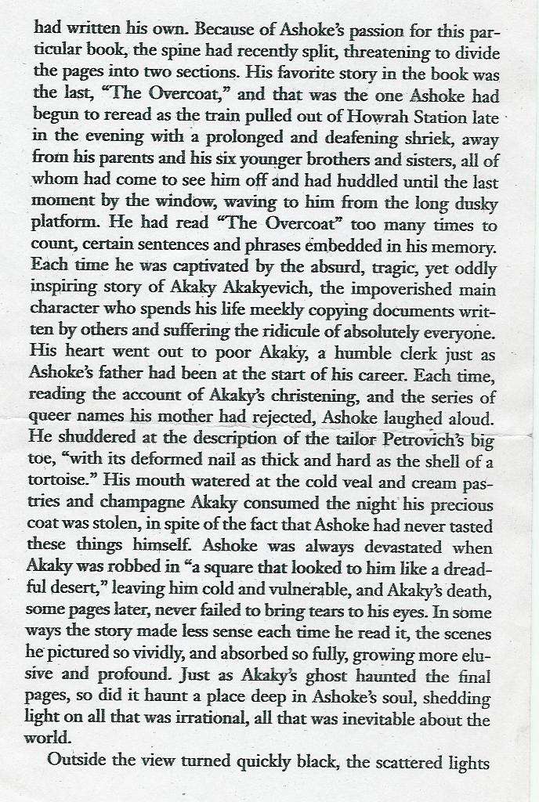
The second page of the reading passage.

Slide 15
Methodology
Spontaneous speech was gathered using the interview method.
The two methods were often combined together. Reading tasks were interspersed with conversation.
A total of 20 hours and 68 minutes recorded material is used in formulating my results.
All the recordings were made in informal situations (at the subjects’ home, in the presence of a few family members) in order to minimize the observer’s paradox.
Data was digitally recorded using an external (lapel) microphone of the frequency 20Hz to 20,000Hz.
Data was sampled at 41 KHz.

Slide 16
Methodology (continued)
Adequate care was taken to include all the categories of consonants and vowels (reading tasks).
For analysis, the data was phonetically transcribed .
The data was then coded using the programme GoldVarb 3.0.

Slide 17
Speaker details
All the subjects interviewed are residents of Delhi (born and brought up in Delhi).
The subjects belonged to the age group of 25 to 30 years.
All of them were graduates.
All of them belonged to middle-class families [all of them owned a flat/2-3 bedroom house, cars, electronic gadgets(like PCs, music system) and worked in private-sector jobs.]
All of them were residents of North and North-West Delhi.
All had exposure to English at an early or later stage of their lives.

Slide 18
Table showing speaker information on their L1s,preferred language of communication , medium of schooling and total hours of recording.
 | L1 | Preferred language for communication |  | Medium of instruction | Total hours of recording
 |  | Formal domain | Informal domain
Speaker 1 | Bangla | English and Hindi | English, Bangla and Hindi | English medium | 1hr 20 mins
Speaker 2 | Bangla | English and Hindi | English, Bangla and Hindi | English medium | 2 hrs
Speaker 3 | Punjabi | English and Hindi | English and Hindi | English medium | 1 hr 40 mins
Speaker 4 | Bangla | English and Hindi | English, Bangla and Hindi | English medium | 2 hrs 54 mins
Speaker 5 | Punjabi | English and Hindi | Hindi and Punjabi | English medium | 1 hr
Speaker 6 | Tamil | English and Hindi | English, Hindi and Tamil | English medium | 1 hr 7 mins
Speaker 7 | Bangla | English and Hindi | English, Bangla and Hindi | English medium | 2 hrs 50 mins
Speaker 8 | Bangla | Hindi | Bangla and Hindi | English medium | 1 hr 30 mins
Speaker 9 | Hindi | English and Hindi | English and Hindi | Hindi medium | 2 hrs 15 mins
Speaker 10 | Punjabi | Hindi and English | Hindi | Hindi medium | 2 hrs
Speaker 11 | Punjabi | Hindi | Hindi | Hindi medium to English medium | 2 hrs 5 mins
Total number of speakers : 11 |  |  |  | Total hours of recording: | 20 hours 68 mins

Slide 19
Speakers’ information
In the above table, all the speakers are tri-linguals i.e. English---- Punjabi-----Hindi
Bangla
Tamil
The information under “preferred language of communication” is divided into two domains.
  Formal domains (office, classroom setting, speaking to unknown people.
  Informal domains (at home, with siblings, friends, colleagues)

Slide 20
Status of Indian English
Status of English in urban India has changed over the past few decades.
By status, I mean the increased use of English language in a variety of domains.
It is no longer restricted to the institutionalised domains like that of school, office, board meetings, etc.
It has percolated to the informal domains such as in social interactions among friends, siblings and parents.
Access to English is no longer restricted to the “elite class”. It has percolated to the middle class as well.
Access to English education has increased and so has the number of English-medium schools.

Slide 21
Nature of speech in Delhi
English co-exists with languages like Bangla, Hindi, etc.
People often borrow and code-switch in the same discourse event (as evident from the spontaneous speech).
English in urban India, Delhi in this case, is potentially open to changes and innovations.

Slide 22
Overall results
The recordings have yielded a total of 6597 tokens, on the basis of which the results are calculated.
My results table shows four dependable variables[s],[z],[Is] and [Iz] across three grammatical contexts and word-internal position.
Overall results show a greater percentage of voicelessness than voicing across the three grammatical categories and in the word-internal category as well.
The percentage of voicing and voicelessness along with the number of tokens inducing it is given along side under (N)

Slide 23
Table showing percentages of voicing and voicelessness across grammatical contexts
[s] |  |  |  | [z] |  | [Is] |  | [Iz] |  | Total
Grammatical contexts | Preceding context | % | (N) | % | (N) | % | (N) | % | (N) | (N)
Plurals | +voice--- | 90 | 4131 | 6 | 294 | 3 | 150 | 1 | 32 | 4607
 | - voice--- | 72 | 1017 | 0 | 0 | 27 | 378 | 2 | 23 | 1418
3rd person singulars | +voice--- | 91 | 87 | 9 | 9 | 0 | 0 | 0 | 0 | 96
 | - voice--- | 87 | 103 | 0 | 0 | 12 | 14 | 1 | 1 | 118
Possessives | +voice--- | 91 | 210 | 9 | 22 | 0 | 0 | 0 | 0 | 232
 | - voice--- | 94 | 75 | 0 | 0 | 1 | 1 | 5 | 4 | 80
Word -internal | +voice--- | 70 | 31 | 30 | 13 | 0 | 0 | 0 | 0 | 44
 | - voice--- | 100 | 2 | 0 | 0 | 0 | 0 | 0 | 0 | 2
Total |  |  |  |  |  |  |  |  |  | 6957

Slide 24
Table showing percentages of voicing and voicelessness in preceding context across grammatical contexts with merged groups.
[s+ Is] All voiceless |  |  |  | [z+Iz] All voiced |  | Total
Grammatical contexts |  | % | (N) | % | (N) | (N)
Plurals | +voice--- | 93 | 4281 | 7 | 326 | 4607
 | - voice--- | 98 | 1395 | 2 | 23 | 1418
3rd person singulars | +voice--- | 91 | 87 | 9 | 9 | 96
 | - voice--- | 99 | 117 | 1 | 1 | 118
Possessives | +voice--- | 91 | 210 | 9 | 22 | 232
 | - voice--- | 95 | 76 | 5 | 4 | 80
Word-internal | +voice--- | 70 | 31 | 30 | 13 | 44
 | - voice--- | 100 | 2 | 0 | 0 | 2
total |  |  |  |  |  | 6957

Slide 25
Frequency of voicing as a function of preceding voiced context (+Voice----)

Slide 26
Details of the preceding context
Consonant categories and vowels | [s] |  | [z] |  | Total
 | % | (N) | % | (N) | % | (N)
*Voiced stops ---- | 92.8 | 1043 | 7.2 | 81 | 19.0 | 1124
Voiceless stops ----- | 99.5 | 1248 | 0.5 | 6 | 21.2 | 1254
Voiced fricatives ------ | 84.4 | 130 | 15.6 | 24 | 2.6 | 154
Voiceless fricatives ---- | 100.0 | 86 | 0 | 0 | 1.5 | 86
Voiced sibilants ------- | 76.8 | 73 | 23.2 | 22 | 1.6 | 95
Voiceless sibilants ------ | 92.2 | 259 | 7.8 | 22 | 4.7 | 281
Liquids ------- | 96.3 | 1393 | 3.7 | 54 | 24.5 | 1447
Vowels ------- | 80.3 | 546 | 19.7 | 134
Nasals ------ | 96.3 | 1421 | 3.7 | 55 | 24.9 | 1476
Phrases, pieces, olives, cliffs, beads, laptops, malls, aspirations.
*Stops: palatals such as [] and [] are included in the category of stops.

Slide 27
Voicing % as a function of the following and preceding contexts
Grammatical contexts |  | ---Voiced |  |  |  | Voiced ---
 |  | [s] |  | [z] |  | [s] |  | [z]
 |  | % | (N) | % | (N) | % | (N) | % | (N)
Plurals | ----- +Voice | 79 | 1131 | 21 | 293 | 93 | 4281 | 7 | 326
 | ----- -Voice | 96 | 630 | 4 | 25 | 98 | 1395 | 2 | 23
3rd person singular | ----- +Voice | 94 | 89 | 6 | 6 | 91 | 87 | 9 | 9
 | ----- -Voice | 97 | 106 | 3 | 3 | 95 | 76 | 5 | 4
possessives | ----- +Voice | 85 | 147 | 15 | 25 | 91 | 210 | 9 | 22
 | ----- -Voice | 100 | 133 | 0 | 0 | 95 | 76 | 5 | 4
Word internal | ----- +Voice | 74 | 31 | 26 | 11 | 70 | 31 | 30 | 13
 | ----- -Voice | - | - | - | - | 100 | 2 | 0 | 0
Total |  |  |  |  |  |  | 6957

Slide 28
Voicing as a function of preceding and following voiced context
Across plurals, possessives, 3rd person singulars and word internal

Slide 29
The effect of a preceding context when a voiced context follows.
Contexts | [z] |  | Examples | Relevant word in the audio clip | Transcription
 | % | (N)
+V---- +V | 23 | 317 |  | Columns and papers | [-   ]
 |  |  |  | Cables of Havel's are very durable | [- ]
-V----- +V | 4 | 26 |  | Branches junior | [ -  ]
 |  |  |  | Forces na | [-  ]
The effect on voicing is greater in inter-voiced contexts.
The effect of a following voiced context is more when the preceding context is also voiced.

Slide 30
What is the norm that people are aiming at?

Slide 31
Table showing percentages of voicing and voicelessness across data types
Data types | Preceding context | [s] |  | [z] |  | Total | Sound clips
 |  | % | (N) | % | (N) | (N)
Word list | +Voice ------ | 98 | 2034 | 2 | 39 | 2073
 | - Voice ----- | 99 | 935 | 1 | 8 | 943
Sentences | +Voice ------ | 92 | 2237 | 8 | 205 | 2442
 | - Voice ----- | 98 | 470 | 2 | 12 | 482
Passage | +Voice ------ | 78 | 100 | 22 | 29 | 129
 | - Voice ----- | 97 | 71 | 3 | 2 | 73
Spontaneous speech | +Voice ------ | 71 | 238 | 29 | 97 | 335
 | - Voice ------ | 95 | 114 | 5 | 6 | 120
Total |  |  |  |  |  | 6957

Slide 32
Frequency of voicing in the preceding voiced (+Voice---)context across data types
Word list (maximum attention paid)
Spontaneous speech (minimum attention paid)

Slide 33
Inferences
The fact that more voicing shows up in spontaneous speech and reading passage and the least voicing shows up in word lists suggests that voicing is not the norm that people are aiming at.
The people of north and north-west Delhi in the age group of 25-30 years are not aiming at voicing in their speech
If the differences across the four data types were to be the results of style shift, one would have expected more voicing in reading tasks and maximally in word lists.

Slide 34
Summary and Conclusions
It can be said that the pedagogical morphophonemic rule which is responsible for voiced and voiceless allomorphs in English does not seem to be operating in the data discussed from Delhi English.
Voicing when it does show up appears to be more a result of the phonological contexts : maximally induced by inter-voiced and the following voiced contexts.
We also find similar voicing alternations word internally- which is clearly a phonological phenomenon. /chrysanthemum/ : [s]~ [z].
[]
[ ]
This provides further support in favour of the phonological nature of the process- even though it is a weak phonological process.

Slide 35
Summary and conclusions
Explanation for greater voicing in sentences, passages and maximally in spontaneous speech?
It can be argued that words spoken in isolation do not provide access to the following contexts. In contrast, sentences, passages and spontaneous speech do provide the following context.
The differences in voicing % across sentences, passages (reading tasks) and spontaneous speech may be explained on the ground that spontaneous speech provides the best connected and uninterrupted following contexts- ideal or optimum phonological context. This is ensured by the rate at which speech is normally delivered in conversational style as opposed to reading styles.
The more favourable effect of a following voiced context further suggests that voicing is induced more at the word boundary rather than at the morpheme boundary.

Slide 36
Thank You

