Slide 1
The Biolinguistic Diversity Index of India
Ritesh Kumar
Centre for Linguistics
Jawaharlal Nehru University
New Delhi

Slide 2
Biolinguistic Diversity: The Theory
The Biolinguistic diversity is a subset of Biocultural diversity which unifies the diversity of life in all of its manifestations: biological, cultural, and linguistic. These are interrelated and have coevolved within a complex socioecological adaptive system.
It is a very recent concept—not more than a decade old—which is based on the fundamental assumption that there is an inextricable link between biological and cultural and linguistic diversity.

Slide 3
Assumptions of Biocultural Diversity
The diversity of life does not only mean the diversity of plants and animal species, habitats, and ecosystems found on the planet, but also the diversity of human cultures and languages.
These diversities are not separate or exist in parallel realms, but rather they interact with and affect one another in complex ways.
The interaction among these diversities have developed over time through mutual adaptation between humans and the environment at the local level, which is, probably, of a coevolutionary nature and, thus, a causal one.

Slide 4
The Beginning
At the international level, an integrated notion of biocultural diversity was first incorporated in the Declaration of Belém of the International Society of Ethnobiology in 1988 at the First International Congress of Ethnobiology in Belém, Brazil. It raised the issue of the simultaneous extinction threats facing tropical and other fragile ecosystems, on the one hand, and indigenous people on the other.
At about the same time, linguists were also beginning to voice widespread concern regarding the status of the world’s languages. They predicted a dramatic disappearance of most of the numerically smaller languages spoken by indigenous and minority people.

Slide 5
The Early Works
It was eight years after the notion of biocultural diversity was posited at the international platform that a work of significance on global biodiversity– linguistic diversity correlations was published by Harmon. It pointed to several large-scale biogeographic factors (like extensive land masses with a variety of terrains, climates, and ecosystems; island territories, especially with internal geophysical barriers; and tropical climates) that might account for these correlations.

Slide 6
The Early Works contd…
At about the same time, Mühlhäusler called attention to the fact that linguistic and cultural distinctiveness can develop also in the absence of mutual isolation: for example, among human groups who belong to the same broadly defined cultural area (i.e. groups sharing many cultural traits), or whose languages are historically related or have undergone extensive mutual contact, and who occupy the same or contiguous ecological niches. Thus it points to the role of sociocultural factors, along with biogeographic factors, in the development of linguistic diversity.

Slide 7
Recent Works
Recently people have begun to realize that there may be structure to linguistic diversity. The functional relationships that develop in space and time among linguistic communities that communicate across language barriers have been referred to as ‘linguistic ecologies’. An ecological theory of language takes as its focus the diversity of languages per se, and investigates the functions of such diversity in the history of humanity. It seeks to identify the mechanisms that sustain language ecology over time and these are, in fact, the very same mechanisms that will be required to build a genuine multilingual and multicultural society in today’s globalised world.

Slide 8
Endangered Biolinguistic Diversity
Tove Skutnabb-Kangas writes that over the last 500 years “about half the known languages of the world have disappeared,” and Michael Krauss estimates that 90% of today’s languages might be extinct in 100 years’ time, leaving only about 600 languages. This gives a very dark picture with respect to the linguistic diversity of the world.
Thus both biodiversity and linguistic and cultural diversity are under a very serious attack and highly endangered.

Slide 9
Significance of 'Biolinguistic'
With the integrated concept of ‘Biolinguistic Diversity’, we will be able to understand the factors affecting both these diversities in a better way.
Since both are positively correlated, it has been estimated that similar factors would be affecting both.
Thus studying both as an integral whole would help in finding better ways of tackling this threat to all the kind of diversities.

Slide 10
IBLD: Calculating the diversities
In order to sustain and protect biocultural diversity we must have a measure of the diversity we have; the diversity we are losing and the rate at which global diversity is decreasing. This will give us insights into the extent, expanse and severity of the problem.
Index of Biolinguistic Diversity (IBLD) is a shorter version of Harmon and Loh’s IBCD (Index of Biocultural Diversity), which calculated the index at the global level, with the country as the reference point.

Slide 11
IBLD: Calculating the diversities contd…
While IBCD took the religious, linguistic, and biological diversity as the variables to calculate the index, IBLD excludes the religious diversity.
Furthermore IBLD also calculates Spearman’s Rank Correlation Coefficient to ascertain the extent to which the biodiversity and linguistic diversity is correlated in that particular region. This has been done because till now there is no concrete proof of a correlation at the intra-country level.

Slide 12
IBLD: The Mathematical Part
The IBLD gives equal weight to cultural and biological diversity, so a country’s overall biolinguistic diversity score is calculated as the average of its linguistic diversity score (LD) and its biological diversity score (BD). IBLD = (LD + BD)/2
In measuring biodiversity BD, equal weight is given to animal species diversity (MD) (using birds and mammals as a proxy for all animal species marine mammals are excluded from the analysis) and plant species diversity (PD). BD = (MD + PD)/2

Slide 13
Rank Correlation Coefficient
Besides this index, I have also calculated Spearman’s Rank Correlation Coefficient to gauge the extent to which the linguistic and biological diversity is correlated within India. It is given by,
σ = [1-{(6Σ d^2)/n (n^2-1)}]
In this formula,
d= difference between the ranks of the two variables
n= Total number of objects for which rank is given.

Slide 14
Ecoregions:The Reference Point
An ecoregion is a relatively large unit of land that contains geographically distinct assemblage of natural communities with boundaries that approximate the original extent of natural communities prior to major land use change. Ecoregions:
• share a large majority of their species and ecological dynamics;
• share similar environmental conditions, and;
• interact ecologically in ways that are critical for their long-term persistence.
The whole globe is divided into 867 ecoregions. Roughly speaking India is divided into 37 ecoregions.

Slide 15
Why Ecoregions??
For calculating the IBLD and comparison within the country, we need a reference point. There were two options before me–
the politically demarcated ‘states’ of India,
The ecoregions, divided on a very scientific basis by WWF, for the specific purpose of studying biodiversities.
Moreover , for ecoregions we have a very well-organised data for the biodiversity, but no data is available for the states.
And so the choice of ecoregions instead of ‘states’ was quite obvious.

Slide 16
IBLD: The Statistical Results
Using the methodology described in the previous slides, I calculated both the rank correlation coefficient and the Index.
Rank Correlation Coefficient has come out to be 0.456.
Biologically, Mizoram-Manipur-Kachin Rain forests are most diverse in India (with an index of 0.8897). However, linguistically it is 8th most diverse region (with an index of 0.6034)

Slide 17
IBLD: The Statistical Results contd…
Linguistically, Brahmaputra Valley semi-evergreen forests are the most diverse with an index of 0.7464. Biologically it is 6th most diverse, having an index of 0.8351.
Biolinguistically, Lower Gangetic Plains moist deciduous forests are the most diverse, with an index of 0.8013; it is followed by Brahmaputra Valley semi-evergreen forests, with an index of 0.7908. Mizoram-Manipur-Kachin Rain forests are the 7th most diverse in India, with an index of 0.7465

Slide 18
Analysis of the Results
The Spearman’s rank correlation coefficient shows some sort of correlation between the biological and linguistic diversity. The range of this coefficient is from -1 to +1, where 0 means uncorrelated and 1 means positively correlated and -1 means negatively correlated. The correlation coefficient of the ranks of biological and linguistic diversity is almost mid-way, although still on the lower side. It proves that they are somehow correlated but this value does not support very highly the hypothesis that the two are correlated.

Slide 19
Analysis of the Results contd…
The rank of the ecoregions on the basis of their linguistic and biological diversity index do not exactly correspond with each other as is shown by the following bar diagram

Slide 20
The Regression Lines
The Regression Lines are used to predict the value of one variable if the value of the other is given. It is these regression lines for biodiversity and linguistic diversity that shows the correlation.

Slide 21
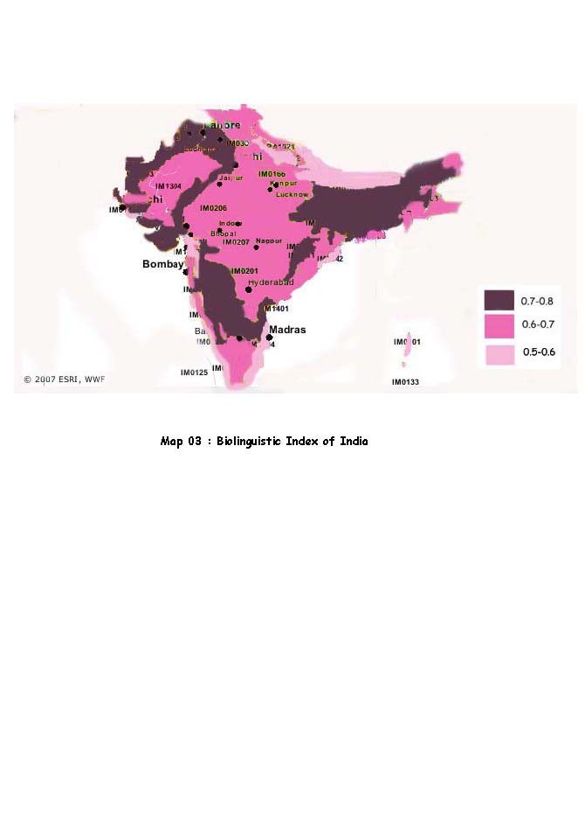
India's Biolinguistic Diversity Index
On the basis of the indices calculated, different ecoregions may be represented as the following. It is a very crude map with some parts of Northern India even not present.

Slide 22
Drawbacks of the present Study
The present study has been completely one-dimensional one. I have calculated the index on the basis of not very authentic data source. Moreover only the data of one particular time is taken into consideration. In order to study the diversity and understand its endangerment properly, we must study it over a period of time and how it has undergone change. Only then will we be able to study the why of the endangerment.

Slide 23
The Future
We need to develop a time-series data for proper study of the issues like fast-depleting diversities.
We also need to look into the methodological issues since as of now the methodology is almost completely statistical one. If we rely completely on statistics, we need to make sure that the data is completely authentic and reliable.

Slide 24
References
1. Carder, Maurice. A Word of Difference, from ‘Resurgence Magazine’ 2008, 250.
2. Gupta, S.C. and V.K. Kapoor (2003). Fundamentals of Mathematical Statistics. Sultan Chand & Sons.
3. Loh, Jonathan and David Harmon. A global index of biocultural diversity, from
‘Ecological Indicators’, 2005.
4. Maffi, Luisa. Language: A Resource for Nature, from ‘The UNESCO Journal on the Environment and National Resources Research’ 1998, 34(4).
5. Maffi, Luisa. Linguistic, Cultural and Biological Diversity, from ‘Annual Review of Anthropology’ 2005.
6. Maffi, Luisa. Biocultural Diversity and Sustainability ‘The Sage Handbook of
Environment and Society’ 2007.
7. Maffi, Luisa. Cultural Vitality, from ‘Resurgence Magazine’ 2008, 250.
8. Skutnabb-Kangas, Tove (2008). Linguistic genocide in Education or Worldwide
Diversity and Human Rights. Orient Longman.

Slide 25
Open to Questions

